Slide 1
Arrays Value Types & References Types
Object Orientated & C#
overview
John Walsh

Slide 2
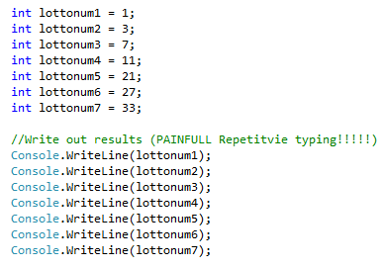
Arrays
Suppose we wanted to store a collection of values of the same type
For example say we wanted to store lotto results
We could do :
Bit Long Winded!!!!

Slide 3


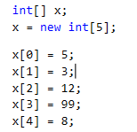

Arrays
So far we have seen the following
An array is a series of elements of the same type placed in contiguous memory locations that can be individually referenced by adding an index to a unique identifier.
That means that, for example, we can store 4 values of type int in an array without having to declare 4 different variables, each one with a different identifier. Instead of that, using an array we can store 4 different values of the same type, int for example, with a unique identifier.
We’ve allocated a space in memory for an int
Called x
We’ve put the value 5 in it
X is an array on ints
Allocate in memory 5 slots
Memory

Slide 4
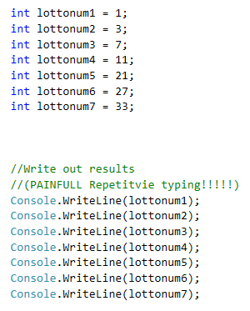
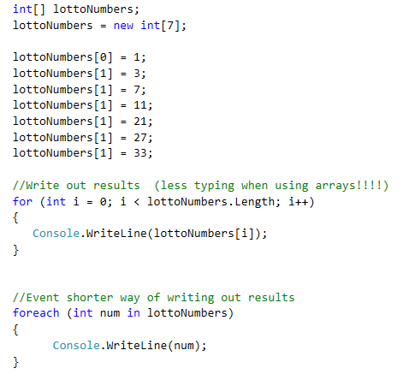
Using arrays
Not using arrays = repetitive typing
Using arrays : can use loops/index to access elements
Repetitive
Much easier

Slide 5
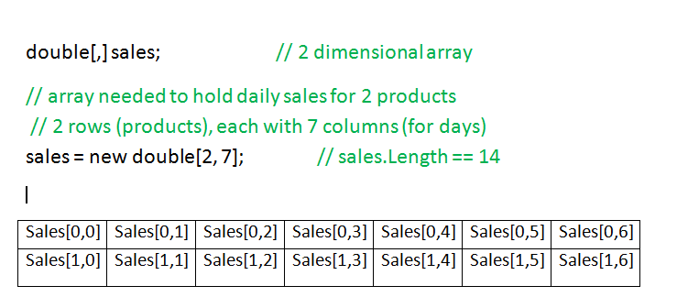
2D array
Product 0
Product 1
Monday Tuesday Wednesday Thursday Friday Saturday Sunday

Slide 6
Value Types versus Reference Types
Primitive types (int, double, float etc) are Value Types
Value types store the value of the type
Int x = 6 ; (x is a slot in memory that holds 6)
Arrays (collections), Classes are Reference types
Reference types don’t hold the value! The hold a reference to a place in memory that does hold the value
BankAccount b = new BankAccount();
B is a slot in memory that hold a reference to a different slot in memory that actually holds the values of the object b

Slide 7

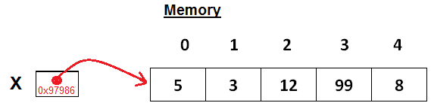
Value versus References (example)
Value Type (int, float, double etc..)
Reference Types (arrays, collections, classes)
X is the name of the int and it stores the VALUE of x
X is the name of a reference to an array of ints
It stores the reference/pointer to the memory slot where the array is.
(x actually stores the address in memory where array is I.e the reference to the array

Slide 8
Stack Versus Heap
The Stack is more or less responsible for keeping track of what's executing in our code (or what's been "called“, local variables etc)
The Heap is more or less responsible for keeping track of our objects and arrays etc.. (stuff we have to ‘new()’ )
Value types are stored straight on the stack (e.g int x below has a value of 5)
Reference types store a reference (a memory address) on that stack, that references memory location on the heap where actual values are stored
Stack
(stores value types and References)
Heap
int x
5
100
BankBalance
Bank Overdraft
200
BankAcc B
0x450506006
Int[] arr
0x54699566
0
1
2

